Slide 1
Heritage Woods Secondary
Tuesday
February 27, 2024
“WE ARE KODIAKS”

Slide 2
Bell Schedule
Block 1 | 8:00 – 9:12
Block 2 | 9:16 – 10:28
FLEX | 10:28 – 10:57
Block 3 | 11:01 – 12:13
LUNCH | 12:13 – 12:53
Block 4 | 12:57 – 2:09
Block 5 | 2:13 – 3:25

Slide 3
No Flex Bell Schedule
Monday, February 05, 2024
Block 1 | 8:00 – 9:12
Block 2 | 9:16 – 10:28
Block 3 | 10:32 – 11:44
LUNCH | 11:44 – 12:28
Block 4 | 12:32 – 1:44
Block 5 | 1:48 – 3:00

Slide 5
If you took a photo on February 12th please come to the office to pickup your Student ID Thank you!

Slide 6
Wear PINK on
Wednesday, February 28, 2024
to support Anti Bullying!
February 28, 2024

Slide 7
February 28, 2024

Slide 8
The Coquitlam School District will be hosting a 3-day Trades Sampler for SD43 Indigenous Students.
As a part of this experience, students will be building "buddy benches" for Hazel Trembath Elementary. Students will learn basic skills in Carpentry, Welding and CNC Machining. Other program highlights include;
• Presentation from ACCESS B.C.
• Connecting with Elders
• Breakfast and Lunch included
• Student Gift -- backpack, T-shirt and more!
• Connecting cultures with trades
• Developing friendships with other SD43 students
Registration deadline: March 14, 2024
March 14, 2024

Slide 9
March 05, 2024

Slide 10
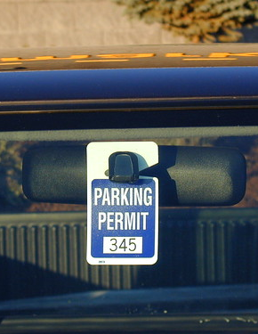
STUDENT PARKING PASSES
Reminder to students who are driving to school and parking in the school parking lots.
Please come to the HWSS main office to register your vehicle and receive a PARKING PASS to be displayed in vehicle. Usually hang from rear view mirror.

Slide 11
Fragrance Free
Reminder to all that SD43 is Scent Aware, and as such the district is asking for cooperation towards a scent reduced environment.
All staff, students and visitors are strongly encouraged to avoid or reduce the use of fragranced products, and to replace them with unscented alternatives.

Slide 12
The following students are asked to please come to the main office to see Ms. Hall:

Slide 13
CLC12 MEETING TIMES
Hey grade 12’s! Please attend your scheduled FLEX time according to the sectioned schedule below.
Refer to TEAMS and/or Email for schedule | Ms. Fester | Rm 102
Refer to TEAMS and/or Email for schedule | Ms. Gay | Rm 103
Refer to TEAMS and/or Email for schedule | Ms. Lee | Rm 244
Refer to TEAMS and/or Email for schedule | Ms. Saloustros | Rm Theatre
Refer to TEAMS and/or Email for schedule | Ms. Nunn | Rm 109
Refer to TEAMS and/or Email for schedule | Ms. Nunn | Rm 109
Refer to TEAMS and/or Email for schedule | Ms. Jarvis | Library
Refer to TEAMS and/or Email for schedule | Mr. Baldus | Rm 311
Refer to TEAMS and/or Email for schedule | Ms. Wood | Rm 202
Refer to TEAMS and/or Email for schedule | Mr. Santarossa | Rm 203
Refer to TEAMS and/or Email for schedule | Ms. Swanson | Library Computer Lab

Slide 14
HWSS LIBRARY
Please come to the Library. The book you requested is now available.

Slide 15
CLUBS

Slide 16
February 28, 2024

Slide 17
March 8, 2024

Slide 18
February 28, 2024

Slide 19
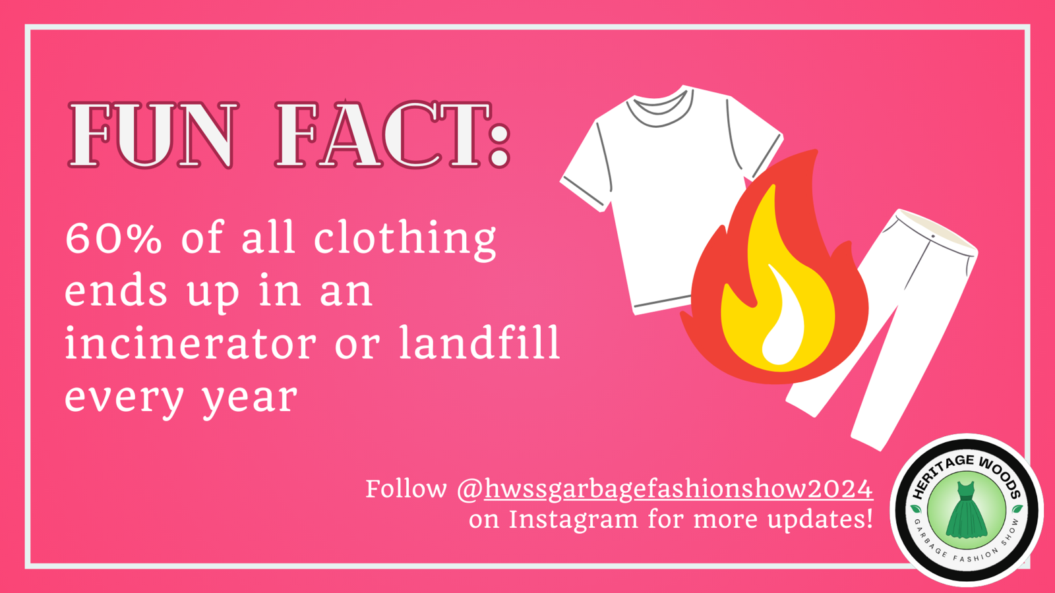
February 28, 2024

Slide 20
February 27, 2024

Slide 21
February 27, 2024

Slide 22
2023/2024 Club Names & Sponsor Teachers If you are interested in joining a club pls contact the sponsor teacher!
Club | Teacher Sponsor
3D Model | Mr. Ferrante
Art | Mr. Ting
Charity Fundraisers | Ms. Pavan
Creative Writing | Ms. Stewart
Curling | Ms. Wood
Dungeons and Dragons | Mr. Blake & Ms. Nezil
Economics | Mr. Sather
Environmental | Mr. Modder
eSports | Ms. Kim & Mr. Blake
First Responders | Mr. Baldus
GO | Mr. Peterson
History | Mr. Chaffee
HOPE | Ms. Fisher
HOST | Mr. Chan
HWSS Dance Team | Ms. Jarvis
Club | Teacher Sponsor
HWSSOAP Peer Tutoring | Mr. Dewolff
Jazz | Ms. Fester
Kodiak Pride | Ms. Leeden
KWAP | Ms. Jarvis
Math | Ms. Weinkam
Outreach | Mr. Zenone
Pet Pals | Ms. Chan
Photography and Film | Ms. Vickerson
Quilting | Ms. Wood
Study Club | Mme. Ferrer
Theory/Music Composition | Ms. Fester
Trading Card Games | Mr. Blake
WYNS | Mr. Clerkson

Slide 23
KODIAK
ATHLETICS

Slide 24
CAREER CENTER

Slide 25
February 29, 2024

Slide 26
Douglas College Next Steps Info Session
If you have applied to Douglas, or are still thinking about applying, be sure to attend this session.
Learn more about:
when you should get your offer
course registration
scholarships & financial aid
supports available to you as a Douglas College student and more
Wednesday February 28 at lunch in the library computer lab
February 28, 2024

